Slide 1


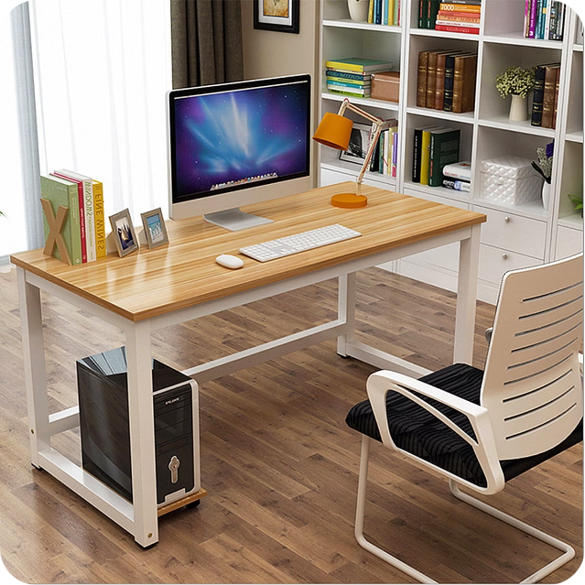
Introduction to Computers
Computers are ubiquitous in our digital world, enabling a wide range of tasks from communication to entertainment. This presentation will provide an overview of the fundamental components, software, and networking that power these versatile devices.
LM

Slide 2
Hardware Components
HARDWARE
Memory
INPUT/OUTPUT
The central processing unit (CPU) is the "brain" of the computer, executing instructions and performing calculations.
RAM (random access memory) temporarily stores data and programs for quick access, while storage like hard drives or SSDs provide long-term data retention.
Devices like keyboards, mice, and displays allow users to interact with the computer, while ports and connectors enable external devices to be attached.

Slide 3

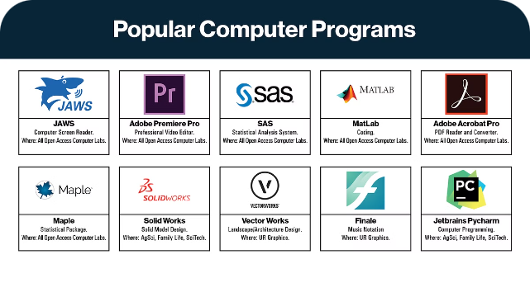
Software and Operating Systems
1
Operating Systems
Manage hardware resources and provide a user interface, such as Windows, macOS, and Linux.
2
Application Software
Enables users to perform specific tasks, like word processing, web browsing, media playback, and more.
3
Drivers and Utilities
Facilitate communication between hardware and software, ensuring devices function properly.

Slide 4

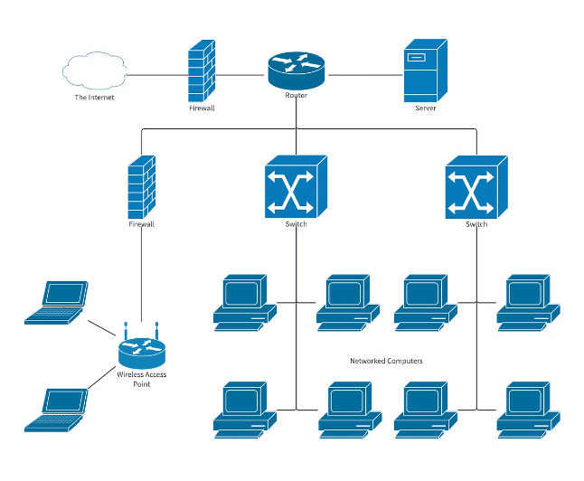
Computer Networks and the Internet
1
Local Area Networks (LANs)
Connect devices within a limited geographic area, such as a home or office.
2
Wide Area Networks (WANs)
Interconnect LANs over larger distances, enabling global communication and the internet.
3
Internet Protocols
Standardize data transmission, allowing devices to communicate and share information worldwide.

Slide 5

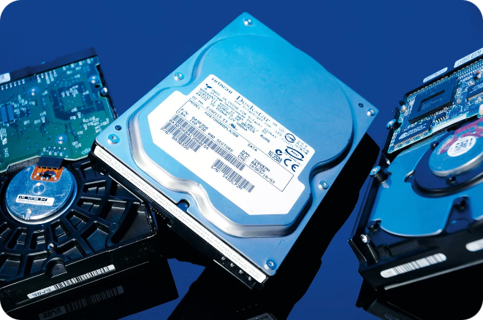
Data Storage and Management
Primary Storage
RAM and caches that provide fast, temporary storage for active data and programs.
Secondary Storage
Hard drives, SSDs, and other devices that offer long-term, persistent data storage.
Cloud Storage
Online storage services that allow remote access to files and data from anywhere.
Data Management
Organizing, securing, and maintaining data through file systems, databases, and backups.

Slide 6


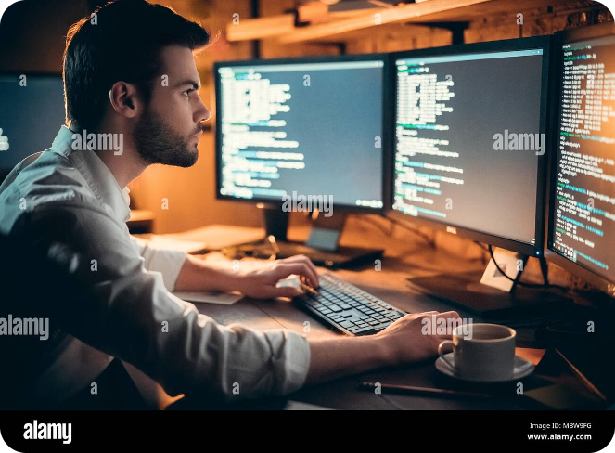



Computer Programming and Coding
Programming Languages
Syntax and rules for writing instructions that computers can understand and execute.
Algorithms
Step-by-step procedures that solve specific problems or perform tasks.
Testing and Debugging
Identifying and fixing errors in code to ensure programs function as intended.
Software Development
The process of designing, building, and maintaining computer programs and applications.

Slide 7

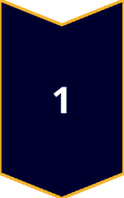
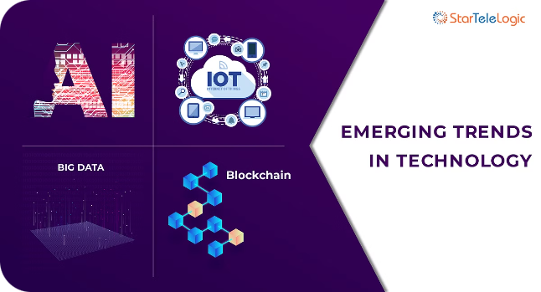

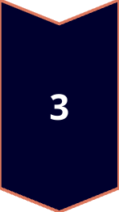
Emerging Technologies
Artificial Intelligence
Machines that can learn and make decisions like humans, powering intelligent assistants and autonomous systems.
Internet of Things
The network of connected devices that can gather and exchange data, enabling smart homes, cities, and industries.
Quantum Computing
Harnessing the principles of quantum mechanics to perform computations far beyond the capabilities of classical computers.

Slide 8
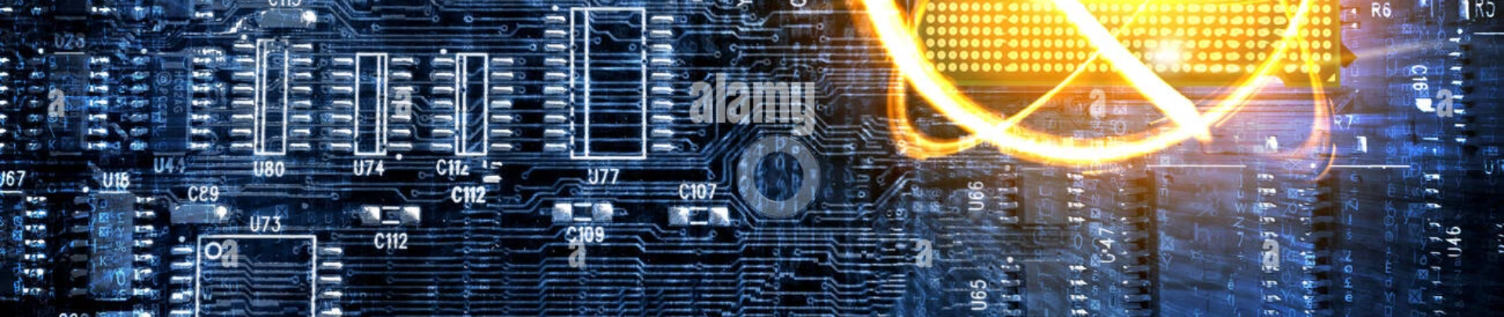
Conclusion and Summary
In this presentation, we've explored the foundational elements of computers, from hardware and software to networking and data management. As technology continues to evolve, emerging innovations are poised to transform how we live, work, and interact with the digital world.

